Slide 1
CAPSTONE PROJECT WINE QUALITY PREDICTION
Presented By:
C.Dhana Priya Tharsini
Regno:950921105003 EEE Department
Holy Cross Engineering College

Slide 2
Outline
Introduction
Problem statement
Objective
System Requirements
Algorithm/Model Used
Result
Application
Reference

Slide 3
Introdution
About Wine:
Wine is a beverage made from fermented grape and other fruit juices with lower amount of alcohol content.
Quality of wine is graded based on the taste of wine and vintage. This process is time taking, costly and not efficient.
A wine itself includes different parameters like fixed acidity, volatile acidity, citric acid, residual sugar, chlorides, free sulphur dioxide, total sulphur dioxide, density, pH, sulphates, alcohol and quality.

Slide 4
Problem Statement
In industries, understanding the demands of wine safety testing can be a complex task for the laboratory with numerous analytes and residues to monitor.
But, our application’s prediction, provide ideal solutions for the analysis of wine, which will make this whole process efficient and cheaper with less human interaction.

Slide 5
Objective
Our Main objective is to predict the wine quality using machine learning through Python programming language
A large dataset is considered and wine quality is modelled to analyse the quality of wine through different parameters like fixed acidity, volatile acidity etc.
All these parameters will be analysed through Machine Learning algorithms like random forest classifier algorithm which will helps to rate the wine on scale 1 - 10 or bad - good.
Output obtained would further be checked for correctness and model will be optimized accordingly.
It can support the wine expert evaluations and ultimately improve the production

Slide 6
System Requirements
HARDWARE REQUIREMENTS
System : Pentinum i3 Processor
Hard Disk : 500 GB
Monitor : 15th LED
Input Devicess : Keyboard,Mouse
Ram : 4 GB

Slide 7
SOFTWARE REQUIREMENTS :
Operating System : Windows 10
Coding Language : Python
Web Framework : Flask

Slide 8
Algorithm / Model Used
Decision Tree
Input
“https://1drv.ms/x/s!Ajm1CYWavWo-g2eqpTzWw29mL3Pl?e=ZSIN0G”

Slide 9
importing
# Loading the required libraries
library('party’)
library('rpart’)
library('rpart.plot’)
library('caret’)
library('ROCR’)
library('randomForest’)
set.seed(46)

Slide 10
Input details
# Loading the dataset
wineData<-read.csv('../input/winequalityN.csv',sep=',',stringsAsFactors=F) str(wineData)
'data.frame': 6497 obs. of 13 variables:
$ type : chr "white" "white" "white" "white" ...
$ fixed.acidity : num 7 6.3 8.1 7.2 7.2 8.1 6.2 7 6.3 8.1 ...
$ volatile.acidity : num 0.27 0.3 0.28 0.23 0.23 0.28 0.32 0.27 0.3 0.22 ...
$ citric.acid : num 0.36 0.34 0.4 0.32 0.32 0.4 0.16 0.36 0.34 0.43 ...
$ residual.sugar : num 20.7 1.6 6.9 8.5 8.5 6.9 7 20.7 1.6 1.5 ...
$ chlorides : num 0.045 0.049 0.05 0.058 0.058 0.05 0.045 0.045 0.049 0.044 ...
$ free.sulfur.dioxide : num 45 14 30 47 47 30 30 45 14 28 ...
$ total.sulfur.dioxide: num 170 132 97 186 186 97 136 170 132 129 ...
$ density : num 1.001 0.994 0.995 0.996 0.996 ...
$ pH : num 3 3.3 3.26 3.19 3.19 3.26 3.18 3 3.3 3.22 ...
$ sulphates : num 0.45 0.49 0.44 0.4 0.4 0.44 0.47 0.45 0.49 0.45 ...
$ alcohol : num 8.8 9.5 10.1 9.9 9.9 10.1 9.6 8.8 9.5 11 ...
$ quality : int 6 6 6 6 6 6 6 6 6 6 ...

Slide 11
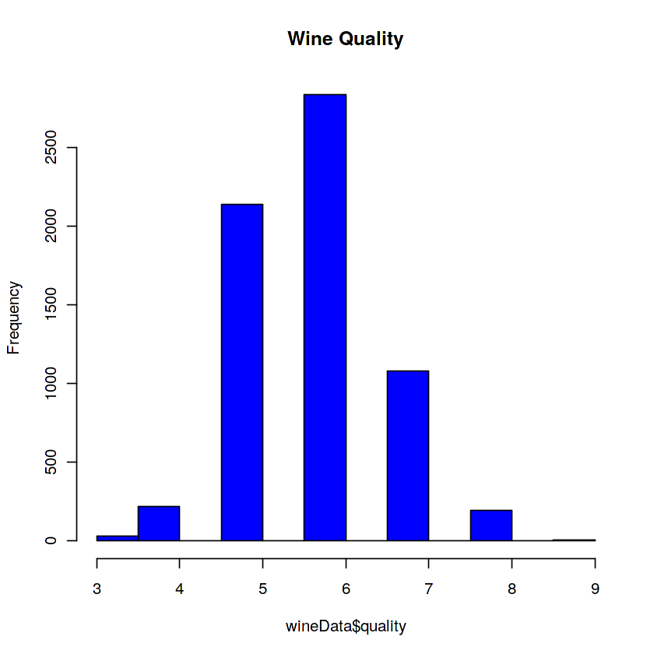
Graph representation
# check the Distribution of the wine quality
hist(wineData$quality, main= "Wine Quality", col= "blue")

Slide 12
# Splitting data into training and testing with 60 and 40 percent respectively
index <- sample(2, nrow(wineData), replace=TRUE, prob = c(0.60, 0.40))
trainingData <- wineData[index==1, ] validationData <- wineData[index==2, ]
# Factorizing the quality variable
qualityFactor <- ifelse(wineData$quality >= 6, "high", "low")
wineData <- data.frame(wineData, qualityFactor)
table( wineData$qualityFactor)
high low
4113 2384

Slide 13
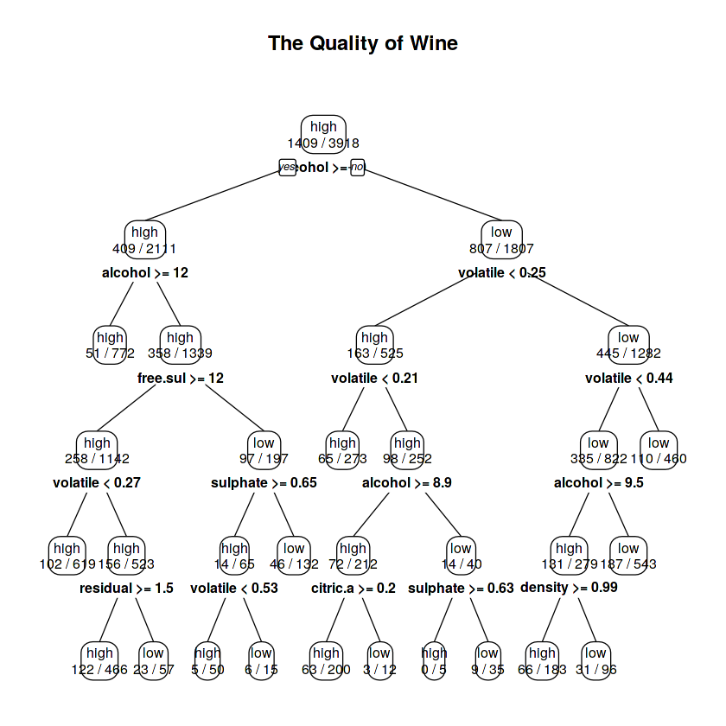
The quality of wine
# Building the rpart model, predicting the value and plotting the decision tree
control <- rpart.control(minsplit = 5L, maxdepth = 5L, minbucket = 5,
cp = 0.002, maxsurrogate = 4) rPartModel <- rpart(qualityFactor~., trainingData,
method = "class",control = control) predict_rpart <- predict(rPartModel, validationData[, -13],
type = "class") prp(rPartModel, type=2, extra=3, tweak=0.8,
main = "The Quality of Wine", compress=TRUE)

Slide 14
predictation
# Predicting the pruned tree prediction <- predict(rPartModel, validationData[, -13], type = "class")
# Generating Confusion Matrix confusionMatrix(prediction, validationData$qualityFactor)
Predicting wine quality involves analyzing various chemical properties of the wine such as acidity, pH levels, and alcohol content. Machine learning models can be trained on datasets containing these properties along with corresponding quality ratings to predict the quality of new wines. Feature selection and engineering play crucial roles in building accurate models. Techniques like regression or classification algorithms such as Random Forest or Support Vector Machines are commonly employed for this task. Cross-validation helps in assessing model performance and ensuring its generalizability. Ultimately, accurate wine quality prediction aids in improving production processes and guiding consumer choices.

Slide 15
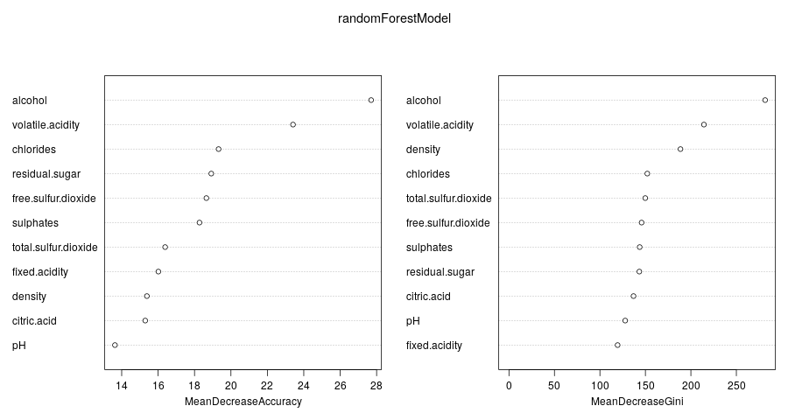
Result
Confusion Matrix and Statistics
Reference
Prediction high low
high 1299 380
low 305 595
Accuracy : 0.7344
95% CI : (0.7169, 0.7514)
No Information Rate : 0.6219
P-Value [Acc > NIR] : < 2.2e-16
Kappa : 0.4265
Mcnemar's Test P-Value : 0.004693
Sensitivity : 0.8099
Specificity : 0.6103
Pos Pred Value : 0.7737
Neg Pred Value : 0.6611
Prevalence : 0.6219
Detection Rate : 0.5037
Detection Prevalence : 0.6510
Balanced Accuracy : 0.7101
“Positive” Class : high

Slide 16
Application
Itis used by the wine manufacturers to improve the quality of the future wines.
Certification bodies can also use the result for quality control.
Results can be used to make wine selection guides for wine magazines.
Results can be used by consumers for wine selection

Slide 17
Reference
“The Classification of White Wine and Red Wine According to Their Physicochemical Qualities,” Int. J. Intell. Syst. Appl. Eng., vol. 4, no. SpecialIssue-1, pp. 23–26, 2016.
[2] E. Summary, W. P. Monitoring, W. Quality, W. Safety, and W. Complexity, “Wine Analysis : from ‘Grape to Glass’ An analytical testing digest of the wine manufacturing process,” 2016.
[3] A. Ghosh, “Project Report : -Red Wine Quality Analysis Final 3 . An empirical Red Wine Quality Analysis of the Portuguese ‘ Vinho Verde ’ wine,” no. December 2017, 2018.
[4] Y. Gupta, “Selection of important features and predicting wine quality using machine learning techniques,” Procedia Comput. Sci., vol. 125, pp. 305–312, 2018.
[5] P. Model, L. Regression, and R. Studio, “Building and Evaluating a Predictive Model w/ Linear Regression in RapidMiner Studio,” 2018.
[6] B. Tajini and O. C. Paris, “Badr Tajini – On Campus Paris – DSTI 2017,” vol. 47, no. 4, pp. 547–553, 2017.

